Slide 1
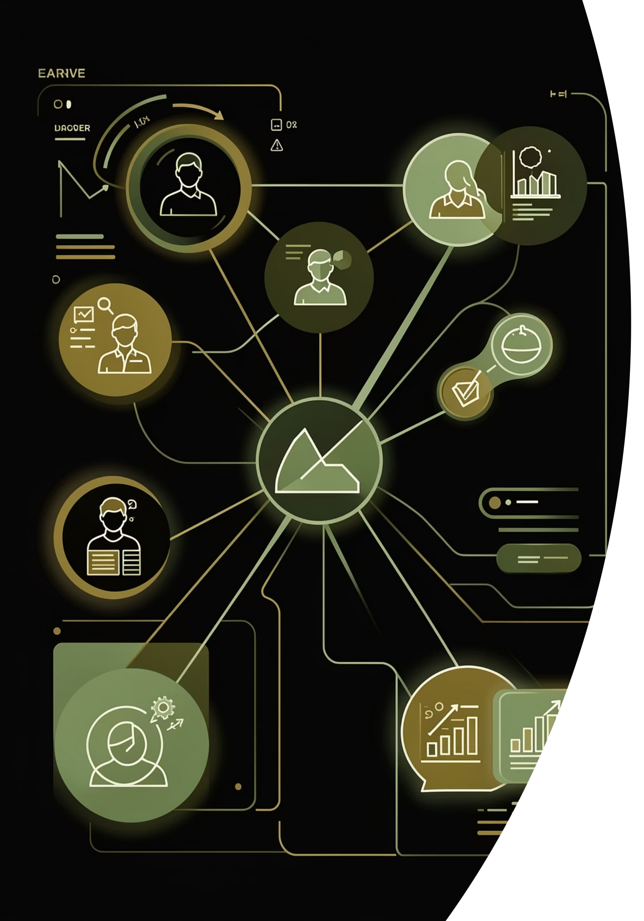
Customer Shopping Behavior Analysis
Uncovering insights from transactional data to guide strategic business decisions.

Slide 2
Project Overview
This project analyzes customer shopping behavior using transactional data from 3,900 purchases across various product categories.
Goal
Data Source
Uncover insights into spending patterns, customer segments, product preferences, and subscription behavior.
Transactional data from 3,900 customer purchases.

Slide 3
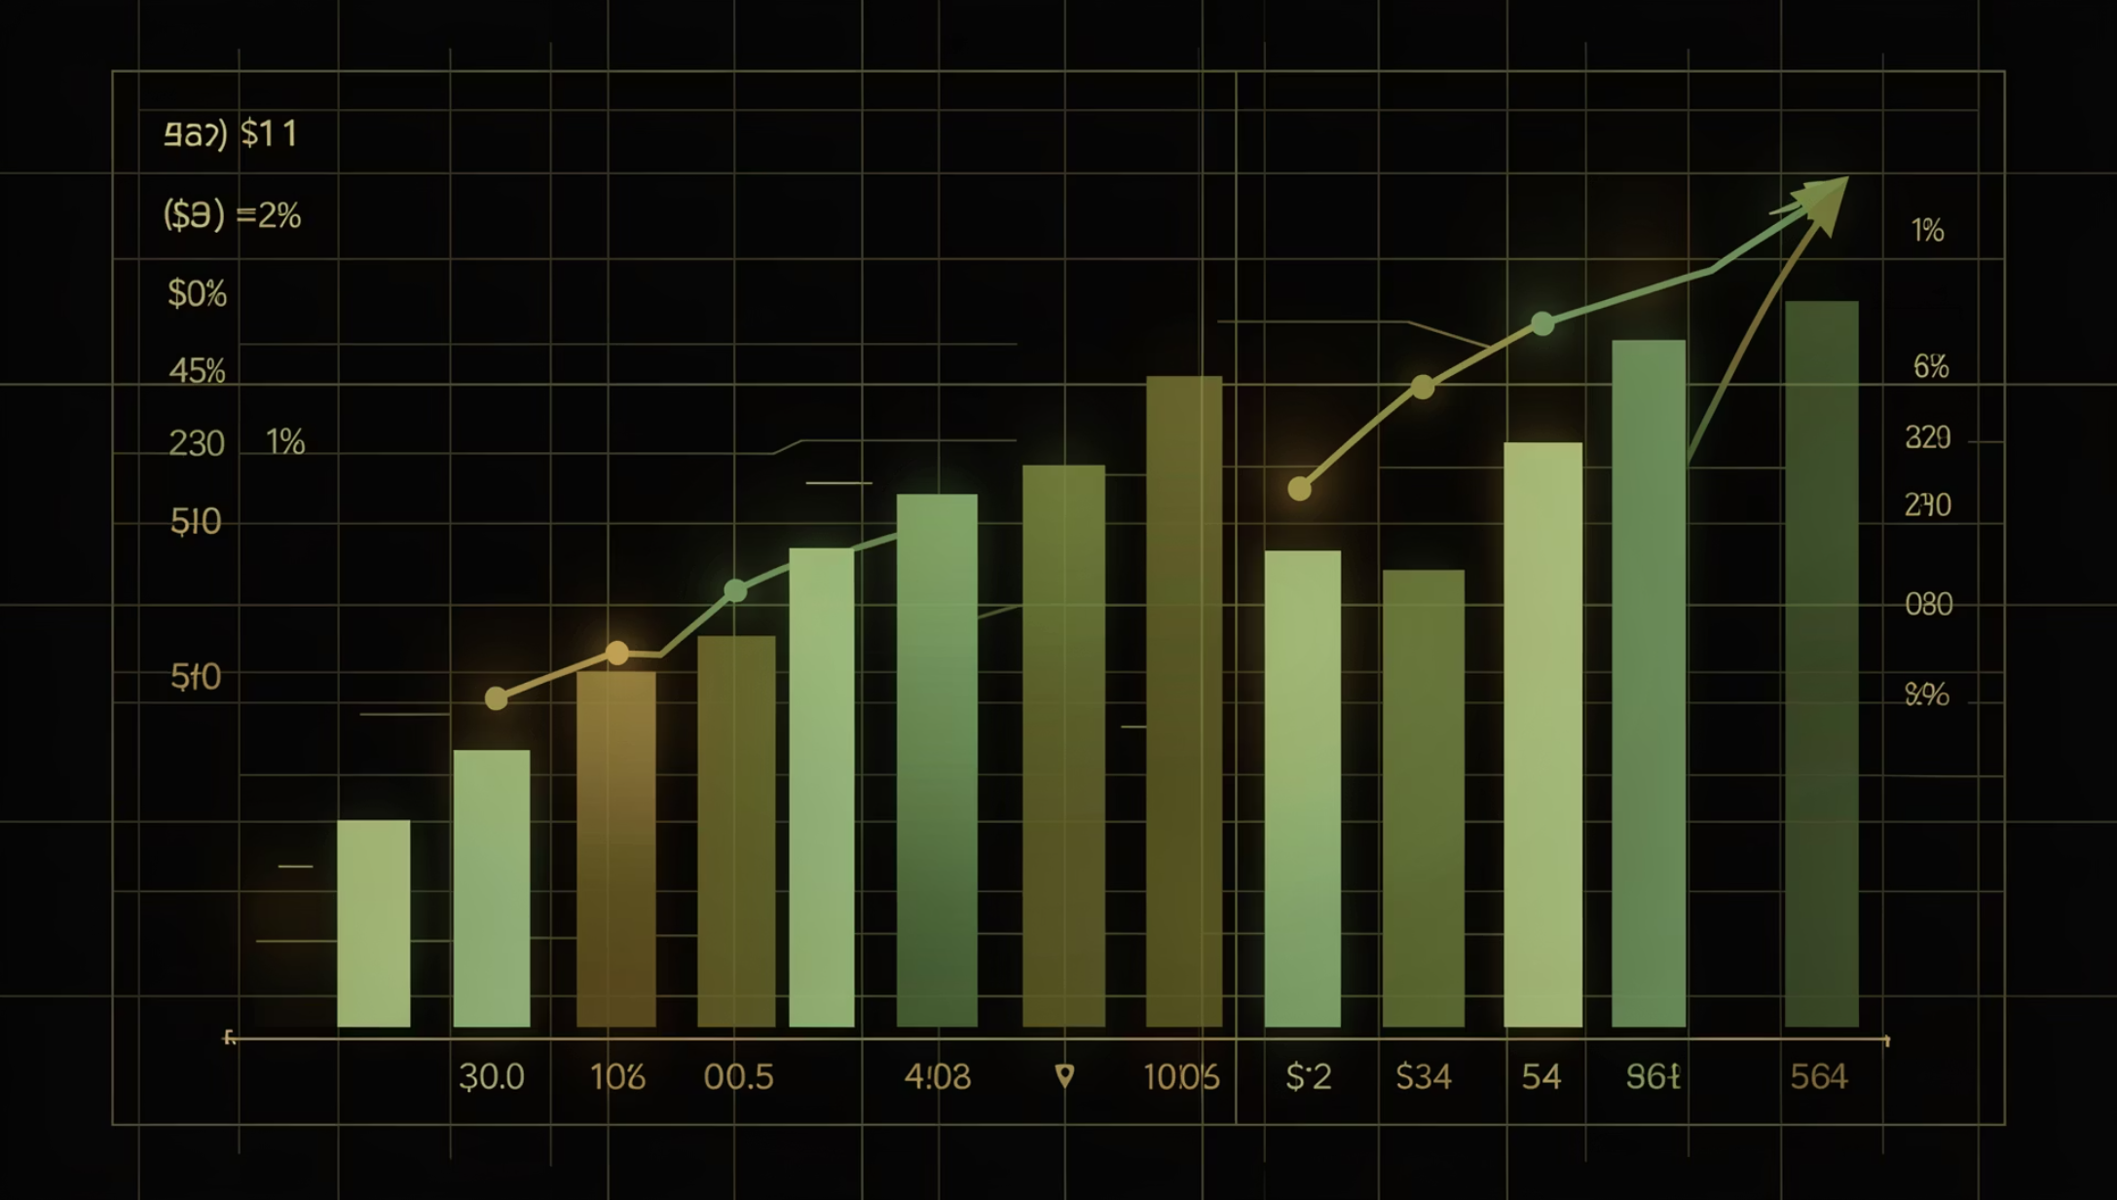
Dataset Summary
Our dataset comprises 3,900 rows and 18 columns, offering a rich view into customer interactions.
Customer demographics (Age, Gender, Location, Subscription Status)
Purchase details (Item, Category, Amount, Season, Size, Color)
Shopping behavior (Discount, Promo Code, Previous Purchases, Frequency, Review Rating, Shipping Type)

Slide 4
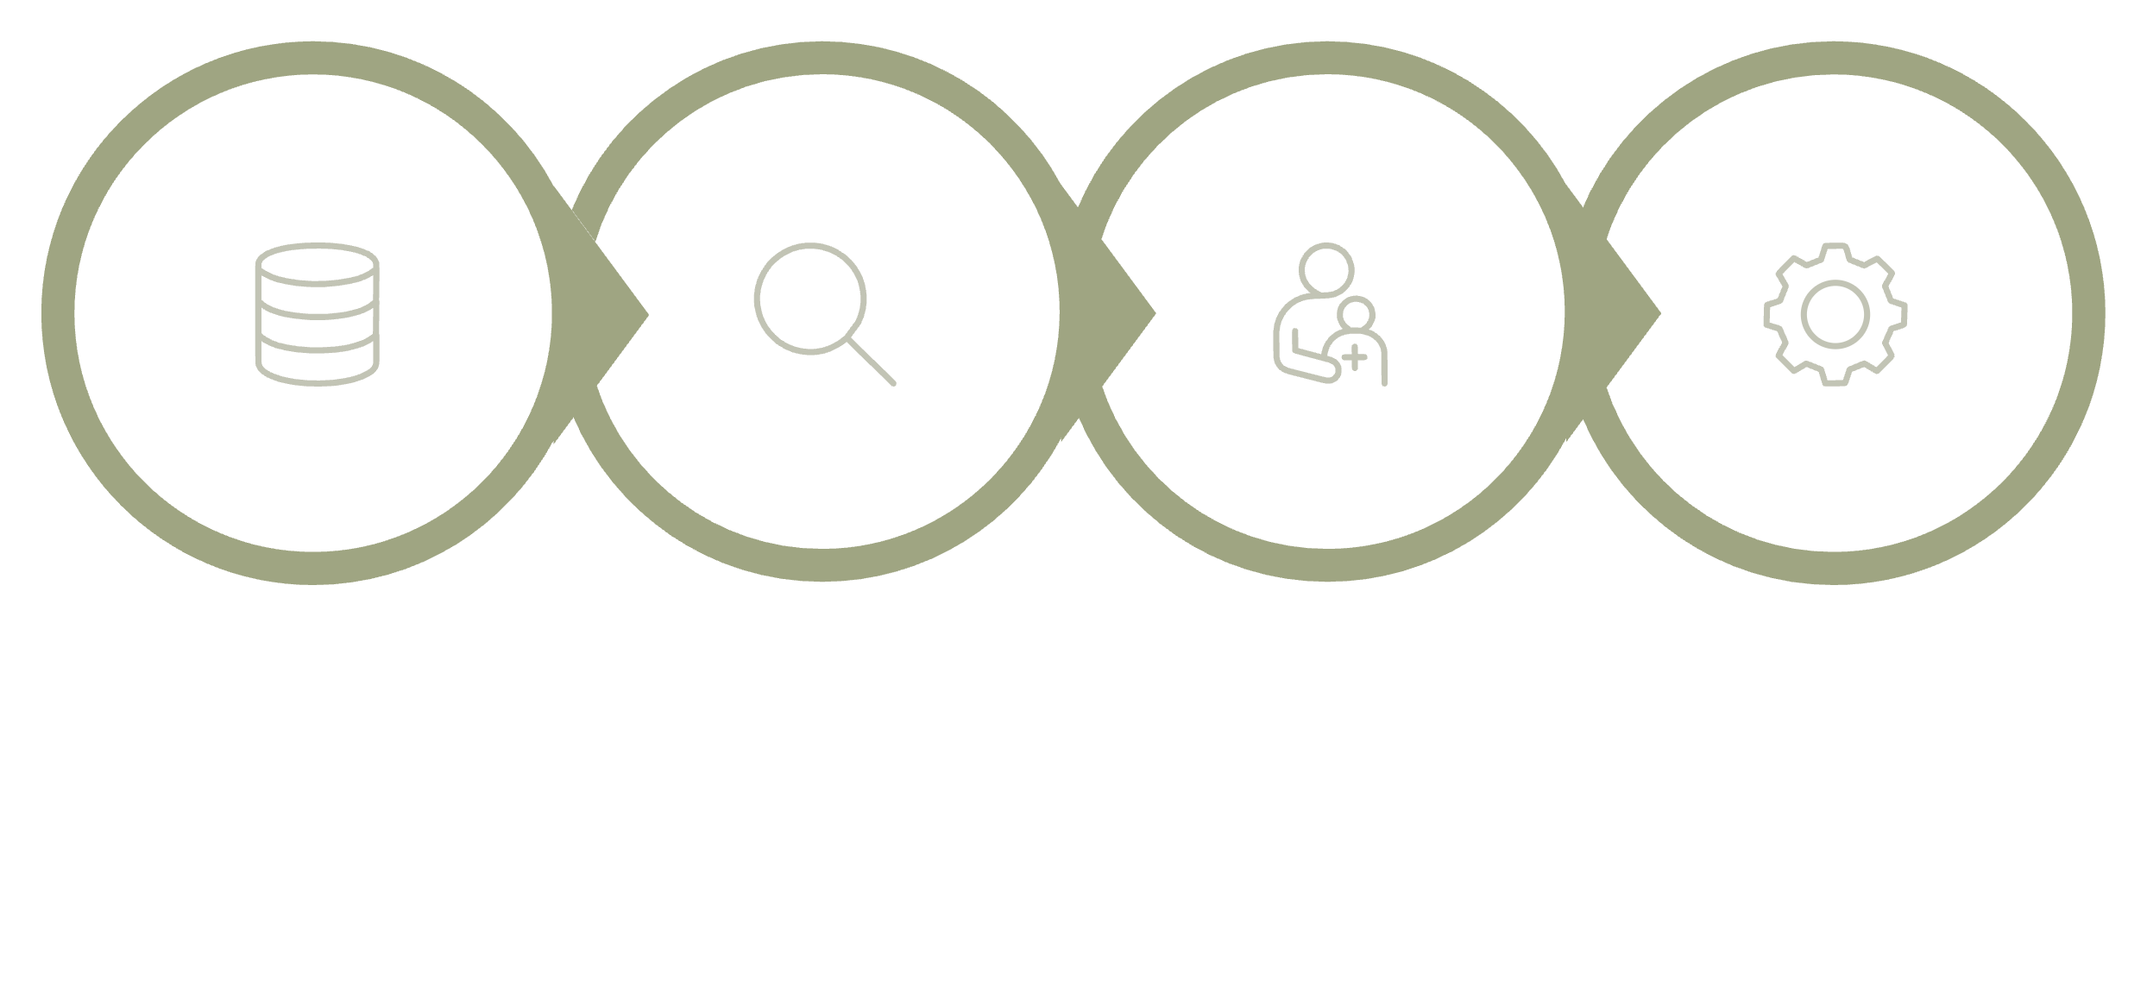

Exploratory Data Analysis (Python)
Initial Exploration
Missing Data Handling
Feature Engineering
Data Loading
We utilized Python for data preparation and cleaning, ensuring a robust foundation for analysis.
Data Loading & Exploration
Data Cleaning
Feature Engineering
Imported data with pandas, checked structure and summary statistics.
Imputed missing 'Review Rating' values using median by product category.
Created 'age_group' and 'purchase_frequency_days' for deeper insights.

Slide 5
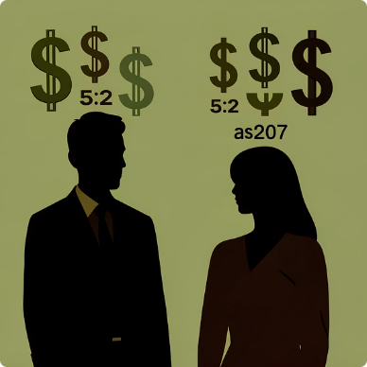

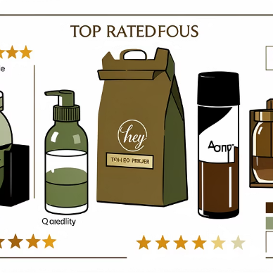
Data Analysis (SQL) - Key Business Questions
Structured analysis in PostgreSQL revealed critical insights into customer behavior.
Revenue by Gender
High-Spending Discount Users
Top 5 Products by Rating
Male customers generated $157,890, while female customers generated $75,191.
Identified 839 customers who used discounts but spent above average.
Gloves (3.86), Sandals (3.84), Boots (3.82), Hat (3.80), Skirt (3.78).

Slide 6
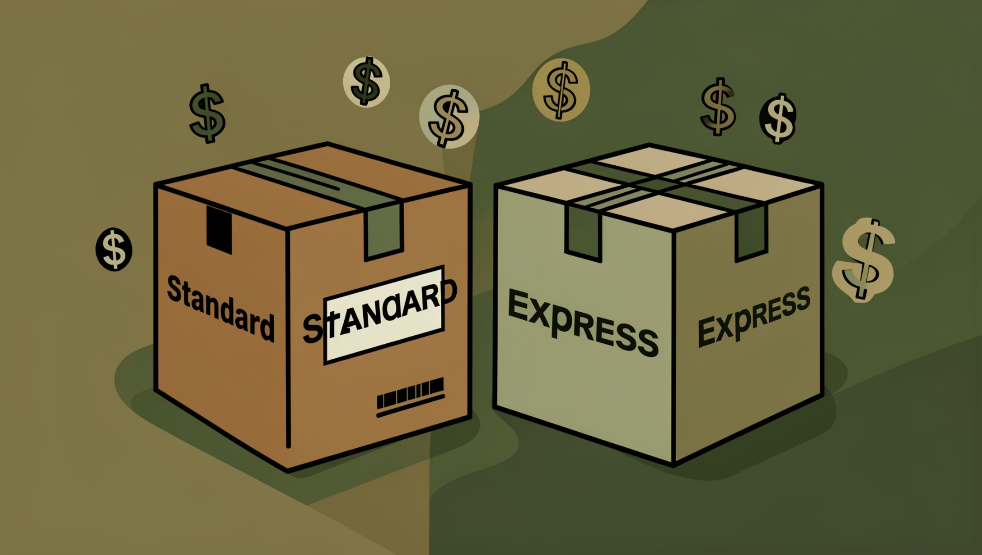
Shipping & Subscription Insights
Shipping Type Comparison
Express shipping users have a slightly higher average purchase amount ($60.48) compared to standard ($58.46).
Subscribers vs. Non-Subscribers
Non-subscribers contribute more to total revenue ($170,436) than subscribers ($62,645).

Slide 7
Product & Customer Segmentation
1
2
3
Discount-Dependent Products
Customer Segmentation
Top Products per Category
Loyal customers (3116), Returning (701), and New (83) segments identified.
Jewelry, Blouse, Sandals, and Jacket are top sellers in their respective categories.
Hat (50%), Sneakers (49.66%), Coat (49.07%), Sweater (48.17%), Pants (47.37%) had the highest discount rates.

Slide 8
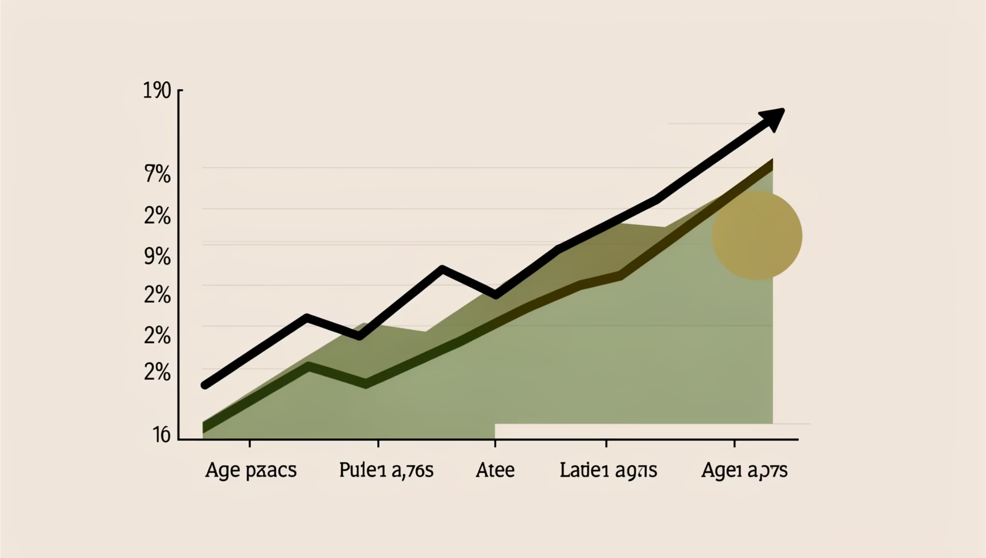
Purchase Frequency & Revenue by Age
Repeat Buyers & Subscriptions
Customers with more than 5 purchases are more likely to subscribe (958 subscribers vs. 2518 non-subscribers).
Revenue by Age Group
Young Adults ($62,143) and Middle-aged ($59,197) groups contribute the most revenue.

Slide 9
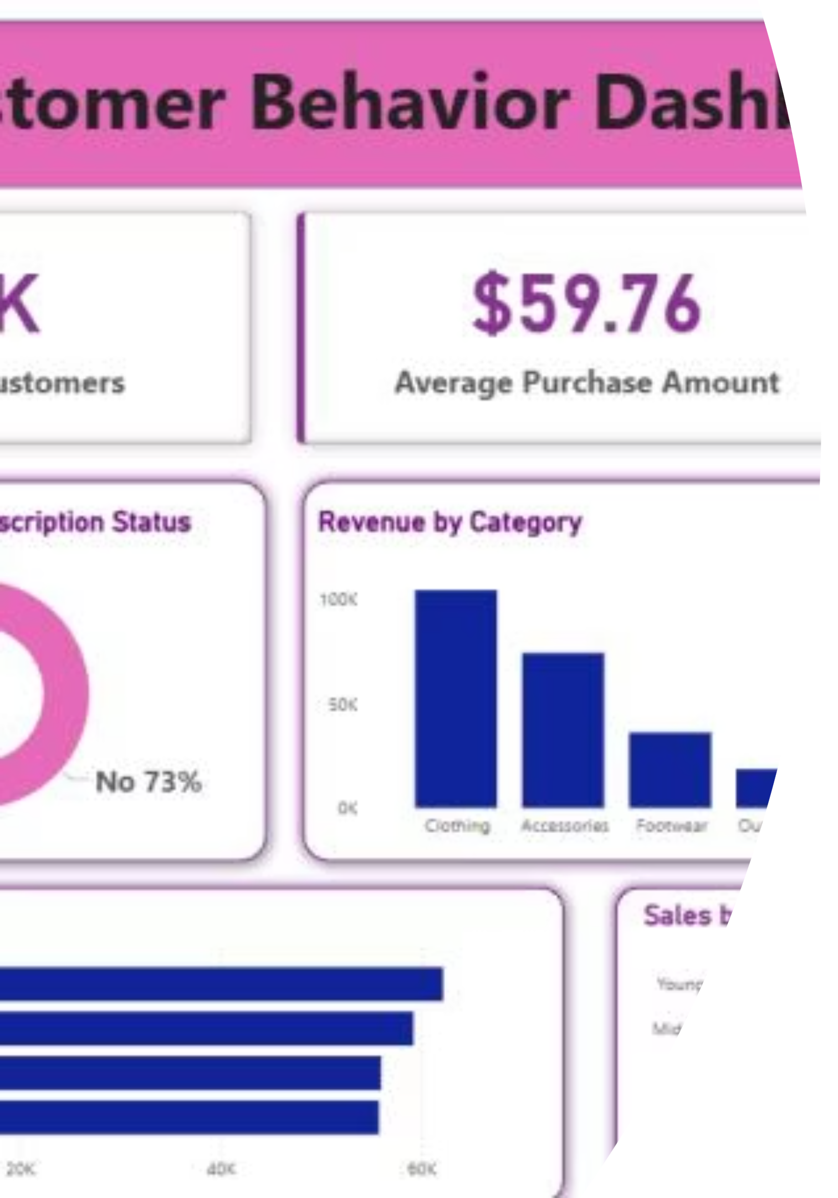
Power BI Dashboard: Visualizing Insights
An interactive Power BI dashboard provides a comprehensive visual overview of customer behavior.
3.9K
$59.76
3.75
Customers
Avg. Purchase
Avg. Rating

Slide 10

Business Recommendations
01
Boost Subscriptions
Promote exclusive benefits to increase subscriber base.
02
Customer Loyalty Programs
Reward repeat buyers to foster loyalty and move them into the “Loyal” segment.
03
Review Discount Policy
Balance sales boosts with margin control for optimal profitability.
04
Targeted Marketing
Focus efforts on high-revenue age groups and express-shipping users for maximum impact.

